Slide 1
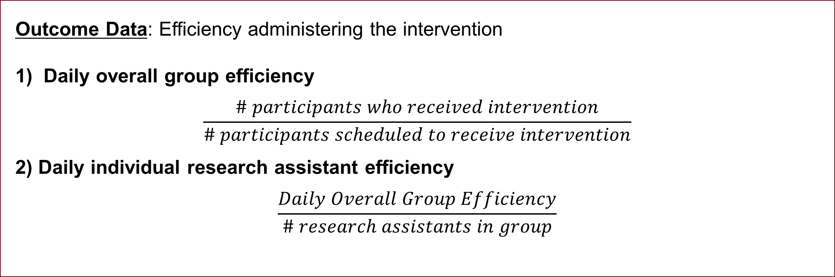
Training to Implement Interventions
Effectively in Schools
Lisa Fitton, MS, CF-SLP, Carly Mellen, & Carla Wood, PhD, CCC-SLP
Purpose
Results
Key Findings
Fostering undergraduate research is a key component of university educational programs in Communication Science & Disorders
Involvement in research helps students connect practice and research (Healey & Jenkins, 2009)
Promotes confidence, positive working relationships with faculty, and critical thinking (Hunter et al., 2010)
Preparing undergraduates to support and engage in high-quality research practices is of increasing importance:
Need for all involved in research to adhere to strict protocols, efficient administration of assessments and intervention and communicate clearly to obtain valid and reliable results (Shadish, Cook, & Campbell, 2002)
Cognitive apprenticeship model proposed by Hagstrom, Baker, and Agan (2009) to train research assistants
Engage undergraduate in relevant coursework and training prior to their participation in faculty research projects (Coston & Myers-Jennings, 2014)
There is a need to explore training strategies to prepare undergraduate students in CSD to engage in mutually-beneficial research partnerships
Outcome Data: Efficiency administering the intervention
Daily overall group efficiency
$$\frac{\# participants who received intervention}{\# participants scheduled to receive intervention}$$
2) Daily individual research assistant efficiency
$$\frac{Daily Overall Group Efficiency}{\# research assistants in group}$$
Supplemental small-group training initially improved research assistants’ efficiency and consistency in intervention administration.
The effect of the intervention did not consistently sustain over time.
Groups including key grant personnel demonstrated noticeably-greater efficiency than groups including only research assistants.
Implications
It is important to address fidelity of implementation, particularly when working with undergraduate research assistants.
Research assistants appear to benefit from individualized training with adult learning strategies incorporated.
Additional attention to providing background information about research projects to implementers is warranted.
Research assistant motivation and interest in the project may be related to productivity on research (based on anecdotal evidence from students).
Undergraduate students require basic training, which may need to be intensive and strategically-designed, when working on research projects.
Overall Group Efficiency Individual RA Efficiency
Research Questions
School One
Is supplemental small-group training effective in increasing research assistants’ group efficiency of intervention administration for a federally-funded grant?
Is supplemental small group effective in increasing individual research assistants’ efficiency of intervention administration for a federally-funded grant?
Do research assistants report improved understanding of the research process after completion of the supplemental training?
School Two
Future Directions
Methods
Explore use of more regular training intervals to maximize research assistant learning and performance.
Identify factors influencing undergraduate students’ readiness to participate in supporting research.
Consider incorporating additional standard preparation in students’ academic curriculums
Examine influence of similarly-structured trainings on research assistants’ performance on additional research tasks, including assessment administration and scoring.
Research Design: Three-group multiple baseline design
Participants: 38 students
Ranged from first-year undergraduates to second-year masters level students
80% were majoring in Communication Science & Disorders
<50% were financially compensated for their work on the grant
Working at three schools to administer interventions to kindergarten and first-grade ELLs
Intervention:
Small-group (3-4 student) training with the first author
Group trainings clustered by school
Training content included:
Importance of efficiency when working on a grant
Importance of the grant intervention in supporting ELLs’ education
Acknowledgement that training can boost research assistants’ skills to administer the intervention effectively and efficiently
Background information related to the content of the intervention being delivered
Adult learning strategies employed:
Encouragement for trainees to draw on past experiences, identifying problems and potential solutions
Opportunities for each trainee to problem-solve
Guided opportunities for trainees to generate information
Adequate wait time (30+ seconds) for trainees during discussion
School Three
References
Participants’ Perspectives on the Training
“I didn’t know why we were doing this… I knew we were helping kids, but I didn’t know how we got the money.”
“I like that we got to talk about this. It was helpful being just four of us.”
“I didn’t realize what we could actually do to get the kids through the intervention faster.”
“I wish we did this at the beginning of the year.”
“Doing the books was kind of crazy sometimes. I think this will help us get through more of them with the kindergarteners especially.”
Coston, J. H., & Myers-Jennings, C. (2014). Engaging undergraduate students in child language research. SIG 10 Perspectives on Issues in Higher Education, 17, 4-16. doi: 10.1044/aihe17.1.4
Hagstrom, F., Baker, K. F., & Agan, J. P. (2009). Undergraduate research: A cognitive apprenticeship model. SIG 10 Perspectives on Issues in Higher Education, 12, 45-52. doi: 10.1044/ihe12.2.45
Healey, M., & Jenkins, A. (2009). Developing undergraduate research and inquiry. York: Higher Education Academy.
Hunter, A-B., Laursen, S. L., Seymour, E., Thiry, F. & Melton, G. (2010). Summer scientists: Establishing the value of shared research for science faculty and their students. San Francisco: Jossey-Bass.
Shadish, W. R., Cook, T. D., & Campbell, D. T. (2002). Experimental and quasi-experimental designs for generalized causal inference. Boston, MA: Houghton Mifflin.
Florida State University • School of Communication Science and Disorders

