Slide 1
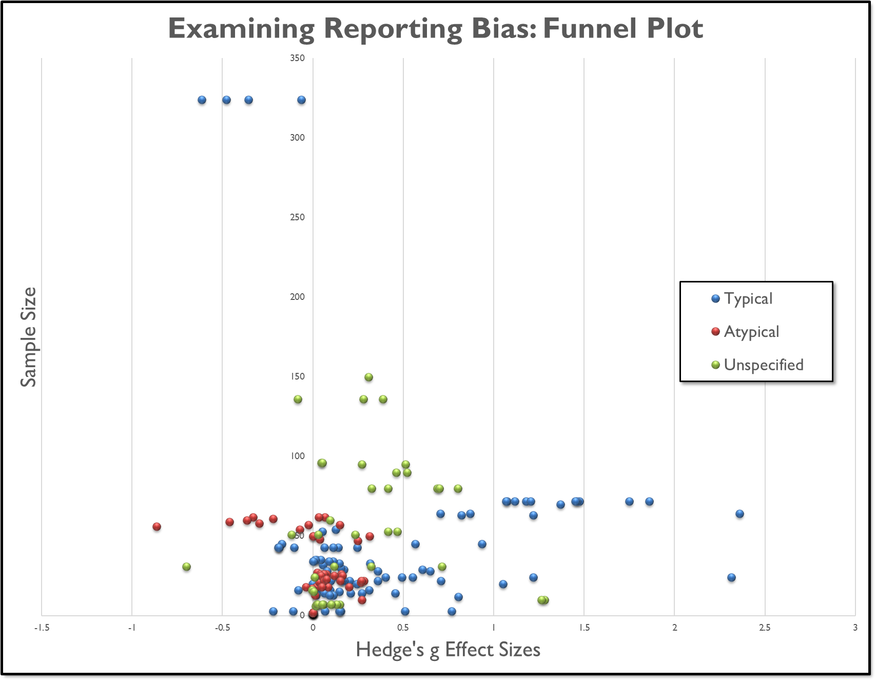
The Impact of Shared Book Reading
on Young ELs' English Outcomes:
A Meta-Analysis
Lisa Fitton, Autumn L. McIlraith, & Dr. Carla Wood
Background
English learners (ELs) are persistently over-represented among students who read at below-basic levels in the United States (Hemphill & Vanneman, 2011)
Early English vocabulary development is critical for young ELs, considering the importance of vocabulary for literacy acquisition (Gough & Tunmer, 1986) and in prediction of later academic outcomes (Kieffer, 2008)
Shared book reading is often recommended as a strategy to build early language and literacy skills (Maynard, Pullen, & Coyne, 2010)
Limited understanding of which components of shared book reading are important to improving ELs’ language and literacy skills
Meta-analysis can assist in examining the mediators and moderators of interventions
Particularly helpful given the range of approaches to storybook reading with ELs
Objectives
To examine the overall impact of shared book reading on English learners’ English vocabulary skills
To identify key mediators and moderators of this intervention approach’s effectiveness
Method
Results
Literature Search & Identification of Studies:
Robust variance estimation used to combine effect sizes in a random-effects model (Hedges, Tipton, & Johnson, 2010):
Average weighted effect size = .280 (SE = .049)
95% CI: .183 to .378 ${\text{t}}^{2}$ = .0847 (assumed ρ = .70*)
Sensitivity Analyses:
Meta-regression conducted in SPSS to examine covariates of interest:
a) Child age, b) Typical/Atypical developmental status of child,
c) Treatment language, and d) Relationship of reader to child
Typical/atypical developmental status and treatment language were not significant after accounting for child age
Meta-regression including child age
Effect size = .306
(SE = .066)
95% CI: .173 to .439
${\text{t}}^{2}$ = .0871 (assumed ρ = .70*)
*Significance of ES held for ρ = .6-.9
 | Effect Size (SE) | 95% CI | ${\text{t}}^{2}$ (r = .70) | # ES Included
Dissertations Removed | .301 (.095) | .101 to .501 | .166 | 76
Experimenter-created measures removed | .173 (.048) | .076 to .271 | ..051 | 95
Non-random assignment removed | .334 (.098) | .129 to .540 | .155 | 58
Alternate treatment controls removed | .410 (.094) | .214 to .606 | .111 | 70
Studies Included
Total studies: 44 Total effect sizes: 169 Total participants: 11,811
Effect Sizes obtained from:
 | Frequency |  | Frequency
Dissertations/Theses | 93 (55.0%) | Between-subjects design | 67 (39.6%)
Peer-Reviewed Pub | 76 (45.0%) | Within-subjects design | 102 (60.4%)
Child Status: |  | Control groups:
Typically-Developing only | 87 (51.5%) | Business-as-usual | 44 (65.7%)
Atypically-Developing only | 17 (10.1%) | Independent book reading | 19 (28.4%)
Typical and Atypical | 25 (14.8%) | Additional instruction | 4 (6.0%)
Unspecified | 40 (23.7%)
Language of reading: |  | Random assignment of groups:
English | 111 (65.7%) | Random assignment employed | 58 (34.3%)
Child’s L1 | 29 (17.2%) | No random assignment | 111 (34.3%)
English and Child’s L1 | 27 (16.0%)
Unspecified | 2 (1.2%)
References
Gough, P., & Tunmer, W. (1986). Decoding, reading, and reading disability. Remedial and Special Education, 7, 6-10.
Hedges, L. V., Tipton, E., & Johnson, M. C. (2010). Robust variance estimation in meta-regression with dependent effect size estimates. Research Synthesis Methods, 1, 39-65.
Hemphill, F. C., & Vanneman, A. (2011). Achievement gaps: How Hispanic and white students in public schools perform in mathematics and reading on the National Assessment of Educational Progress (NCES 2011 459). NCES, Institute of Edu. Science., U.S. Dept. of Edu. Washington, DC.
Kieffer, M. J. (2008). Catching up or falling behind? Initial English proficiency, concentrated poverty, and the reading growth of language minority learners in the United States. Journal of Educational Psychology, 100(4), 851-868.
Maynard, K. L., Pullen, P. C., & Coyne, M. D. (2010). Teaching vocabulary to first-grade students through repeated shared storybook reading: A comparison of rich and basic instruction to incidental exposure. Literacy, Research, and Instruction, 49, 209-242.
Florida State University • School of Communication Science and Disorders

